Slide 1
Introduction to Yoga
Yoga is a holistic practice that integrates the physical, mental, intellectual, and spiritual aspects of the human personality. It is derived from the Sanskrit word 'YUJ', meaning to join, yoke, or unite, signifying the unification of the individual self (Jivatma) with the universal consciousness (Paramatman). This introduction will explore the definitions, historical development, and key objectives of yoga.

Slide 2
Meaning and Concept of Yoga
Yoga Yajnavalkya
Unification of individual psyche (Jivatma) with the transcendental (Paramatman).
Jesus Christ
Physical body as the living temple of God.
Patanjali
Complete suppression of all mental modes (Cittaorttinivodha).
Vyasa
Absorptive concentration (samadhi).

Slide 3
Benefits of Yoga
Swami Sathyananda Saraswati (1999)
Yoga as valuable inheritance and essential for today and future culture.
Hassanagas (1996)
Improves general health, mental capabilities, concentration, memory, self-confidence, and self- discipline.
Reduces psycho-physical fatigue and injuries.
Decreases illness-related absences, increases efficiency and productivity.

Slide 4
Historical Development of Yoga
1
Origin and History
Classical Yoga system by Patañjali in Yoga Sūtras. Eightfold system of Yoga: Yama, Niyama, Asana, Pranayama, Pratyahara, Dharana, Dhyana, Samadhi. Pre-Patañjali references in Purāṇas, Mahābhārata, Upaniṣads. Hiraṇyagarbha as instigator.
2
Indus Valley Civilization (3000 B.C.)
Evidence of yoga practice from stone seals.

Slide 5
Psychological Aspects Leading to Yoga
1
Psychological Reasons for Origin
Desire for happiness (Sukha-pravritti) and termination of sorrow (Dukha-nivritti).
2
Psychological Reasons for Origin
Curiosity about self and life realities.
3
Psychological Reasons for Origin
Realization of suffering as permanent and enjoyment as temporary.
4
Psychological Reasons for Origin
Knowledge of suffering's nature, cause, and end, leading to yoga as a means to overcome suffering and attain bliss.

Slide 6
The Timeless Tradition of Yoga
Yoga's origins trace back over 5000 years, rooted in ancient Indian traditions. It is heavily influenced by Vedic philosophy and the Tantras, ancient texts that provided a spiritual foundation for its practices.
Significant contributions came from Patanjali, who around 200 BCE compiled the Yoga Sutras, a comprehensive guide on yoga philosophy and practice. Buddha, who lived around 500 BCE, emphasized meditation as a core component of spiritual practice. During the medieval period, notable yogis like Matseyendranātha and Gorakṣanātha further refined yoga practices, contributing to the rich historical tapestry of yoga's evolution.

Slide 7
The Eight Limbs of Yoga
Yama
1
Ethical standards and moral conduct, focusing on focusing on principles such as non-violence (Ahimsa), truthfulness (Satya), non-stealing (Asteya), continence (Brahmacharya), and
non-covetousness (Aparigraha).
2
Niyama
Personal observances including cleanliness (Saucha), contentment (Santosha), austerity (Tapas), self-study (Svadhyaya), and surrender to a surrender to a higher power (Ishvara Pranidhana). Pranidhana).
Asana
3
Physical postures designed to promote physical physical health, flexibility, and stability.
4
Pranayama
Breath control techniques aimed at enhancing the enhancing the flow of prana (life energy) and
and mental clarity.
Pratyahara
5
Withdrawal of the senses from external objects, objects, directing attention inward.
6
Dharana
Concentration on a single point or object, cultivating focus and mental discipline.
Dhyana
7
Meditation, a continuous flow of concentration concentration leading to heightened awareness.

Slide 8
The Principles of Karma Yoga
Sanchita Karma
Pravabdha Karma
Kriyamana Karma
Accumulated actions from past lives, lives, which influence one's current current life circumstances.
The portion of past karma that is responsible for the current life and its experiences.
Actions being performed in the present, which shape future outcomes.
Karma Yoga, also known as the yoga of action, emphasizes selfless service and devotion without attachment to the results. Swami Vivekananda highlighted different types of karma, including Sanchita Karma, Pravabdha Karma, and Kriyamana Karma. Key principles of Karma Yoga include performing actions with the right motive, maintaining focus on the divine, and serving others selflessly, without attachment to the outcomes.

Slide 9
Major Yoga Asanas
1
Suryanamaskara (Sun Salutation)
Halasana (Plough)
2
A dynamic sequence of poses that warms up the the body and promotes flexibility.
A pose that enhances spinal flexibility and calms the nervous system.
3
Matsyasana (Fish)
4
Sarvangasana (Shoulderstand)
Opens the chest and strengthens the back muscles, muscles, improving respiratory function.
Improves circulation, stimulates the thyroid, and and promotes overall health.

Slide 10
Pranayama Techniques
Surya Bhedhana
Ujjayi
Seetkari and Shitali
Bhastrika
Right nostril breathing to to increase heat and energy in the body.
Constricting the throat slightly to produce a soft, soothing sound during inhalation and exhalation, promoting mental clarity and calmness.
Cooling breaths taken through the mouth to reduce body heat and stress.
Forceful, rhythmic breathing to energize and and purify the body.

Slide 11
Yoga in Jainism and Buddhism
Jainism
Yoga incorporates principles of non-violence (Ahiṃsā), (Ahiṃsā), sensory withdrawal (Pratyāhāra), and deep deep contemplation (Dhyana). Jains practice yoga as a as a means of spiritual purification and self-discipline,
discipline, aiming to achieve liberation (moksha) from the
from the cycle of birth and death (samsara).
Buddhism
Buddhism emphasizes Vipāsanā meditation, focusing on focusing on observing the breath and the impermanent impermanent nature of thoughts and sensations. The The Eight-fold Path guides practitioners towards ethical ethical conduct, mental discipline, and wisdom. Yoga in Yoga in Buddhism is practiced to cultivate mindfulness, mindfulness, reduce suffering, and achieve enlightenment (nirvana).

Slide 12
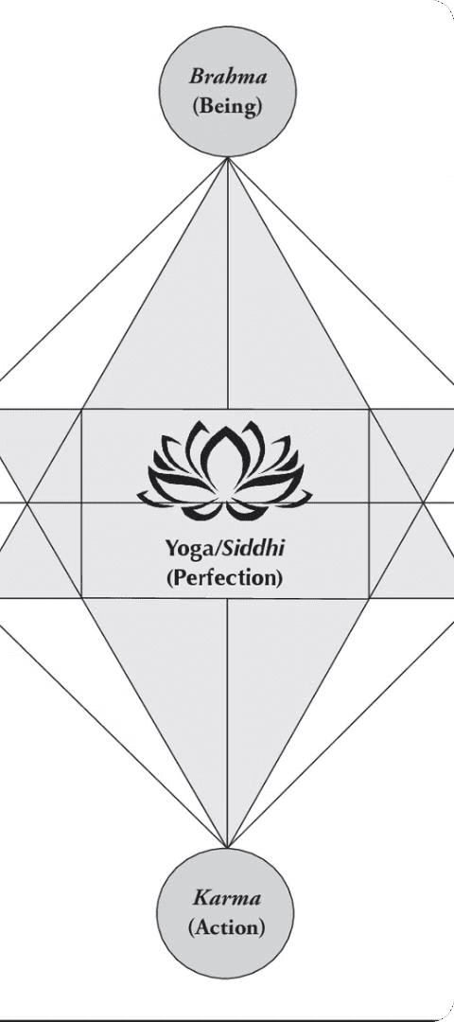
Integral Yoga by Sri Aurobindo
Holistic Transformation
Comprehensive Approach
Sri Aurobindo's Integral Yoga combines various aspects of yoga to achieve a holistic transformation of the individual. It integrates physical, mental, and spiritual practices to harmonize all aspects of the self.
Integral Yoga aims at a complete and and harmonious development of the of the individual, transcending traditional yogic paths to create acomprehensive approach to spiritual growth.

Slide 13
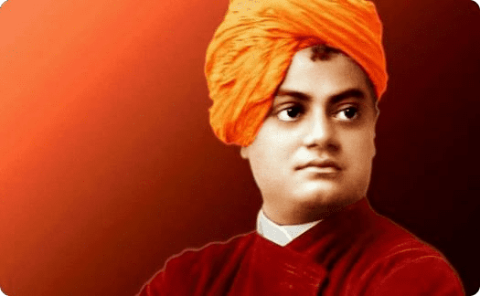
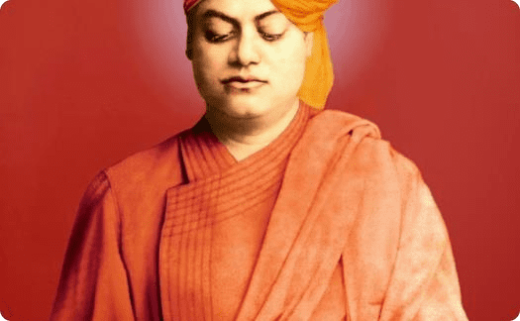
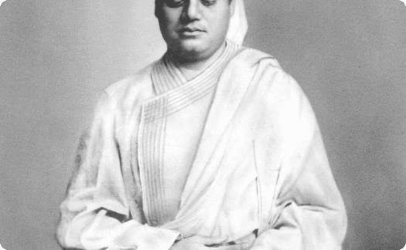
The Contributions of Swami Vivekananda
Vedanta for the World
Integrating Yogic Paths
Practical Spirituality
Swami Vivekananda's contributions to modern yoga include making the principles of Vedanta accessible to a global audience.
He promoted the integration of different yogic paths (Karma Yoga, Bhakti Yoga, Raja Yoga, Jnana Yoga) to Yoga) to achieve holistic self-realization. realization.
Vivekananda emphasized the importance of practical spirituality, encouraging individuals to apply yogic yogic principles in their daily lives for for personal growth and societal well- well-being.

Slide 14
Dhavana, Dharana, and the Path to Samadhi
Explore the ancient yogic practices of Dhavana, Dharana, Dhyana, and Samadhi - the journey from broad attention to blissful awareness and spiritual union. Discover the elements of Dharana, the benefits of Dhyana, and the categories of Samadhi. Uncover the power of Asanas, Surya Namaskar, and the profound impact of yoga on physical and mental health.

Slide 15
Dhavana and Dharana: Cultivating Focus
Dhavana
Dhavana is a broad-based field of attention, akin to concentration. It is the first step in the journey towards deeper focus and awareness.
Dharana
Dharana is the practice of concentration on a single object, enhancing mental focus. It involves various elements, including Bhuvo-dharana, Varini-dharana, Vaisvanari-dharana, Vayavi-dharana, and Nabho- dharana.

Slide 16
Dhyana: The Art of Meditation
1
Continuous Contemplaton
Dhyana, or meditation, is the continuous contemplation or concentration on a sacred object. It is a state of deep relaxation and mental freshness.
2
Steady Lamp
Meditation is likened to a steady lamp, unaffected by the wind of worldly thoughts, representing the calmness and continuous awareness it cultivates.
3
Profound Benefits
The benefits of meditation include deep relaxation, reduced metabolic rate, mental freshness, calmness, and continuous awareness.

Slide 17
Samadhi: The Pinnacle of Yoga
Blissful Awareness
Samadhi is the state of blissful awareness and spiritual absorption, where the individual consciousness merges with the universal consciousness.
Categories of Samadhi
Samadhi has various categories, including Laya Samadhi, Savikalpa Samadhi, Nirvikalpa Samadhi, Sahaja Samadhi, and Mahasamadhi.
Spiritual Union
Samadhi represents the ultimate goal of yoga, the union of the individual self with the divine, transcendent reality.

Slide 18
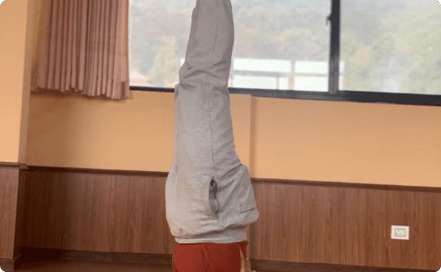
Asanas: The Foundations of Yoga
Sitting Postures
Asanas, or yogic postures, provide stability and comfort. They include sitting postures like Padmasana, Vajrasana, and Paschimottanasana.
Lying Postures
Asanas also include lying postures such as Powanamutasana, Sarvangasana, and Halasana, which offer physical, mental, and spiritual benefits.
Standing Postures
The practice of Asanas encompasses standing postures like Tadasana, Urdhavahastottanasana, and Padhastasana, further enhancing the holistic benefits of yoga.

Slide 19
Surya Namaskar: Honoring the Sun
Pranamasana
Surya Namaskar, or Sun Salutation, is a sequence of 12 yoga poses performed with 12 mantras, including the Pranamasana (Prayer Pose).
Hastauttanasana
The sequence also includes the Hastauttanasana (Raised Arms Pose), which helps access ethereal energy and promote overall well- being.
Hasta Padasana
Another key pose in the Surya Namaskar sequence is the Hasta Padasana (Hand to Foot Pose), designed to enhance physical, mental, and spiritual energy.

Slide 20
Yoga and Cardiovascular Health
Blood Pressure Reduction
Diabetes Management
Yoga techniques can help lower blood sugar levels for non-insulin dependent diabetes patients, and regular practice can lead to a reduced need for anti- diabetic medication, improving overall metabolic health.
Yoga has been shown to reduce both systolic and diastolic blood pressure, with minor improvements compared to health education but better than no treatment. It can be an effective adjunct therapy for hypertension management.
1
2
3
Pulmonary Function Improvements
Yoga practice has been found to improve lung function in healthy individuals and those with chronic bronchitis and asthma, leading to significant enhancements in pulmonary function tests and exercise capacity for asthma patients.

Slide 21
Yoga and Mental Health
Tension Reduction
Flexibility Restoration
Fear Avoidance
Yoga provides profound benefits for mental health, including the reduction of tension, restoration of flexibility, and avoidance of fear.
Yoga enhances personal values, acceptance of faith, and social values, contributing to improved mental peace, stability, and overall well-being.
Regular yoga practice has a significant positive impact on mental health, promoting mental stability and overall well-being.

