Slide 1
UNIT-4
LEARNING RESOURCES
Need and significance of learning resources in Physical Science - Identifying and analyzing the learning resources in teaching-learning process of Physical Science - Physical Science Laboratory as a learning resource - Use of Science and Physical Science experiment kits in teaching - learning of Physical Science - Field visits and excursion as learning resource in Physical Science - ICT based virtual experiments and simulations as learning resource in Physical Science - Role of the teacher -Limitations and hurdles in the use of various learning resources in Physical Science.

Slide 2

Learning Resource – Meaning
Used by teachers in imparting information
Technologies and internet
Brilliant for teachers and educators to help them deliver best quality lessons
To help and assist
Effective classroom instruction

Slide 3
Characteristics of Teaching-Learning Resources
Attractiveness:Teaching resources should be visually appealing and engaging to capture students' attention.
Familiarity: Resources that are familiar to students can help them feel more comfortable and confident in their learning.
Novelty: Introducing something new and exciting can spark curiosity and motivation.
Utilization: Effective teaching resources should be versatile and have multiple uses.
Multiple Utility: Resources that can be used in various ways are more valuable.
Ease of Handling: Teaching resources should be easy to use and manipulate.

Slide 4
Functions of Resources
Act as a stimulus to learning
Help to organize the teaching learning process
Embody a view of the nature of teaching
Reflect the nature of the learning tack
Provide models of correct and appropriate language use

Slide 5
Type of Resources
The resources available in the resource center are of two types.
1. print-based resources, and
2. Non-print based resources.:
1. Print-based Resources:
• These are mainly of five types:
• Reference books and manuals
• Textbooks
• collections
• Periodicals, technical and professional magazines and journals collection
• Instructional materials

Slide 6
2. Non-print based resources:
Non-print based resources include audio-visual equipment which can be classified under audio, still image projection, moving image projection and other categories. Audio equipment consists of audio tape player, audio cassette player with headphones, audio tape recorder playback, audio variable speed playback and recorder, record players stereo, and radio. Still Image projection equipments include stereo viewer.

Slide 7
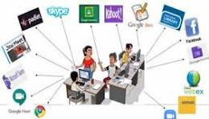
ICT RESOURCE
Radio
Television
Multimedia
Interactive white board

Slide 8
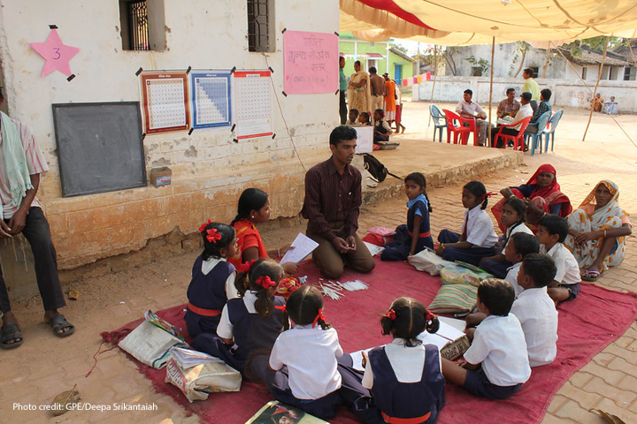
Community Resources
-Museum
-Exhibition/ Fair
Laboratory source
Experiment kits
Field visit and Excursion
ICT based Virtual Experiment and Simulations.

Slide 9
Advantages of Instructional media
Save time
Increase interest
Hold attention
Clarify ideas
Reinforce concepts
Aid memory
Helps to teach abstract concepts

Slide 10
Resource Island
Centrally located area in a classroom
Charts, maps, text-books, dictionaries and other day-to-day teaching resources
All sides of the classroom
Work sheets
Power points
Books and dictionaries
News paper & magazines

Slide 11
Resource Peninsula
An area on one side of a classroom
Miniature resource center
Includes printed materials
digital or non- digital materials

Slide 12
Off-line Digital Learning Resources
Bank
CD-Rom
CAI
Application Software
Games

Slide 13
Guidelines for selecting Teaching-Learning Resources
Student's needs
Finding right teaching
Curriculum appropriate
Sufficient background
Knowledge Suitable for the age and
the class feedback

Slide 14
Role of the Teacher
In a resource center, the teacher should:
Plan and organize the distribution of resource materials.
Arrange the time-table for the use of the center.
Plan and arrange accommodation including the layout of the furniture and equipment.
Ensure the maintenance and repair of furniture and equipment, disposal of irretrievably broken and obsolete machines and update the resources.
Arrange and maintain exhibition.
Maintain an efficient system for recording the use of and re-ordering of consumable materials.

Slide 15
Role of Learners
In the resource center, the learners should:
• get the required resources by themselves.
• find the resources and get them issued.
• return the resources to the resource center after their use.
• maintain discipline while working in the resource center.
• help in maintaining and arranging the resources in the resource center.
• inform the teacher or resource center staff in case of any mishappening.
• encourage their fellow-leanlers to use the resource center to the maximum.
• inform the resource center staff about their special requirements. develop their own resources.

Slide 16


