Slide 1
UNIT-III THEORY OF CONSTRUCTIVISM AND LEARNER CENTERED TEACHING
    Meaning and definitions of Constructivism
    The nature of constructivist learners
    The nature of learning process.
        Pedagogical approaches to constructivism
    Characteristics of learner -centered teaching and learning
      Advantages of learner-centered teaching vs teacher – centered learning.

Slide 2
Meaning of Constructivism
Constructivism is the theory that says learners construct knowledge rather than just passively take in information.
Constructivism is based on the idea that people actively construct or make their own knowledge, and that reality is determined by your experiences as a learner.
Constructivism’s central idea is that human learning is constructed, that learners build new knowledge upon the foundation of previous learning.
This prior knowledge influences what new or modified knowledge an individual will construct from new learning experiences (Phillips, 1995).
This model was entrenched in learning theories by Dewey, Piaget, Vygotsky, Gagne, and Bruner

Slide 3
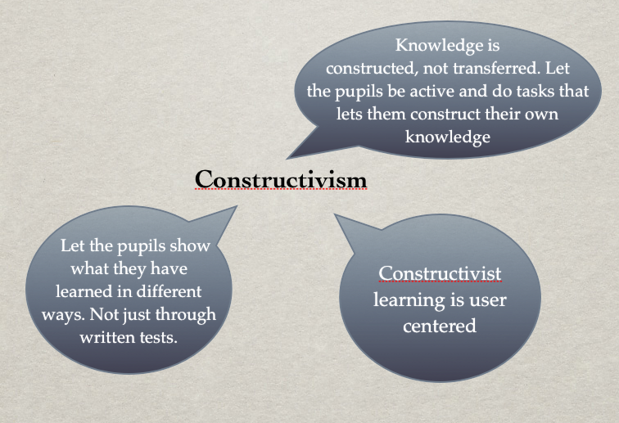

Slide 4
Definition of Constructivism
Constructivism in psychology is a method of therapy that focuses on both the internal and external systems of meaning- making.
Humans create knowledge through the interaction between their experiences and ideas.- Jean Piaget
Jerome Bruner's Constructivist Theory suggests that learning is an active process and that learners construct meaning from their previous experiences.
Dewey believed that learning should be interactive and that students should be encouraged to explore and discover new information on their own. This approach to education is aligned with constructivism, which emphasizes the active role of the learner in the learning process

Slide 5
The nature of constructivist learners
Motivation: the level of interest and drive to learn a particular subject or skill.
Prior knowledge: the existing background knowledge and experiences that can affect how new information is processed and understood.
Learning style: the preferred method of acquiring and processing information, such as visual, auditory, or kinesthetic.
Attitudes and beliefs: the perceptions and attitudes towards learning, such as self-efficacy and self-concept.
Socio-cultural context: the cultural, social, and economic factors that can affect learn.

Slide 6
The nature of learning process.
Learning involves active cognitive processing.
Learning is adaptive.
learning is subjective, not objective.
Learning involves social, cultural and individual processes.
learning should involve social negotiation and mediation
Learning should take place in authentic and real-world environments.
Knowledge is constructed rather than innate, or passively absorbed

Slide 7
The nature of learning process
learning is an active rather than a passive process.
Learning is a social activity – it is something we do together, in interaction with each other, rather than an abstract concept.
The passive view of teaching views the learner as ‘an empty vessel’ to be filled with knowledge, whereas constructivism states that learners construct meaning only through active engagement with the world (such as experiments or real-world problem-solving).
John Dewey valued real-life contexts and problems as an educational experience.
Learning exists in the mind - Learners will be constantly trying to develop their own individual mental model of the real world from their perceptions of that world

Slide 8
Pedagogical approaches to Constructivism
Pedagogical approaches to constructivism refer to the teaching and learning methods based on the constructivist theory of learning, which states that learners actively construct knowledge through experiences, interaction, and reflection rather than passively receiving information.
In this approach, the teacher acts as a facilitator or guide, and students build their own understanding by connecting new information with prior knowledge.

Slide 9
Pedagogical approaches to Constructivism
Learning
Content and skill
Student should be assessed formatively
Gagne’s 8 levels of learning
  Signal
  Stimulus response
  chaining
  verbal association
  Discrimination learning
  Concept learning
  Rule learning
  problem solving

Slide 10
Key Features:
Learner-centered approach
Active participation in learning
Use of real-life problems and contexts
Collaboration and social interaction
Reflection and critical thinking
Teacher as a facilitator, not a transmitter of knowledge

Slide 11
Problem-Based Learning (PBL)
  Students are given real-life problems to solve.
  Encourages critical thinking, inquiry, and teamwork.
Project-Based Learning
  Learners work on a long-term project that integrates multiple subjects.
  Promotes creativity, planning, collaboration, and presentation skills.
Discovery Learning
  Students learn through exploration and experimentation rather than direct instruction.
  Encourages curiosity and self-directed learning.
Collaborative/Cooperative Learning
  Students work in groups to solve problems or complete tasks.
  Enhances communication, teamwork, and peer learning.

Slide 12
Learner-Centered Teaching and Learning
Meaning
Learner-centered teaching and learning is an educational approach that focuses on the needs, abilities, interests, and learning styles of students.
It shifts the role of the teacher from being a knowledge-giver to a facilitator and guide, while students take an active role in constructing their own knowledge.

Slide 13
Definition
“Learner-centered teaching and learning is an approach where the emphasis is placed on the learner’s active participation, responsibility, and engagement in the learning process, with the teacher acting as a facilitator who guides, supports, and motivates.”

Slide 14
Characteristics
Active Participation – Students are actively involved in learning activities.
Learner Autonomy – Encourages self-directed learning and decision-making.
Collaborative Learning – Peer interaction, group discussions, teamwork.
Personalized Learning – Focuses on learners’ interests, abilities, and pace.

Slide 15
Characteristics
Teacher as Facilitator – Teacher guides, supports, and motivates instead of just delivering content.
Critical Thinking & Problem Solving – Emphasis on inquiry, creativity, and reasoning.
Experiential Learning – Learning through experiences, projects, and real-life tasks.
Continuous Feedback – Ongoing assessment and reflection help improve learning.

Slide 16
Learner-Centered Teaching – Advantages
Active engagement – Students participate and construct knowledge.
Develops critical thinking – Encourages problem-solving and creativity.
Personalized learning – Adapts to students’ needs, pace, and interests.
Promotes collaboration – Group discussions, teamwork, and peer learning.
Improves motivation – Students feel ownership of their learning.
Encourages lifelong learning – Builds self-directed learning skills.
Focus on skills – Communication, cooperation, and decision-making.

Slide 17
Teacher-Centered Learning – Advantages
Efficient for large groups – Easy to manage and deliver to many students.
Time-saving – Covers syllabus quickly through lectures.
Clear structure – Content is organized and directly presented.
Useful for beginners – Helps when students lack prior knowledge.
Strong teacher control – Classroom discipline and order are easier.
Standardized delivery – Ensures all students receive the same content.

Slide 18


