Slide 1
UNIT – IV: SCHOOL ADMINISTRATION
School administration : Meaning, nature, aims, objectives and principles – Institutional planning– School complex – Democratic administration in education – School plan – Time table – Role of Headmaster / Headmistress and Teachers in school administration

Slide 2
Meaning of School Administration:
Management of Resources:
School administration involves managing various resources, including human resources (teachers, staff), financial resources, and physical resources (buildings, equipment).
Coordination and Leadership:
It involves coordinating the efforts of different stakeholders (students, teachers, parents, community) and providing leadership to ensure effective implementation of policies and programs.
Creating a Positive Learning Environment:
The core function of school administration is to create a conducive environment for learning, teaching, and overall development of students.

Slide 3
Nature of School Administration
Human-Centered:
School administration is focused on the needs and well-being of students, teachers, and other staff members.
Dynamic and Adaptive:
School administration must be adaptable to changing educational needs, technological advancements, and community expectations.
Collaborative:
It involves working collaboratively with different stakeholders to achieve shared educational goals.

Slide 4
Aims and Objectives of School Administration
Academic Excellence: To provide quality education and ensure students achieve their full academic potential.
Student Development: To foster the intellectual, social, emotional, and physical growth of students.
Community Engagement: To build strong relationships between the school and the community.
Teacher Professional Development: To support teachers in their professional growth and development.
Resource Management: To ensure efficient and effective use of resources to maximize the impact of the school.

Slide 5
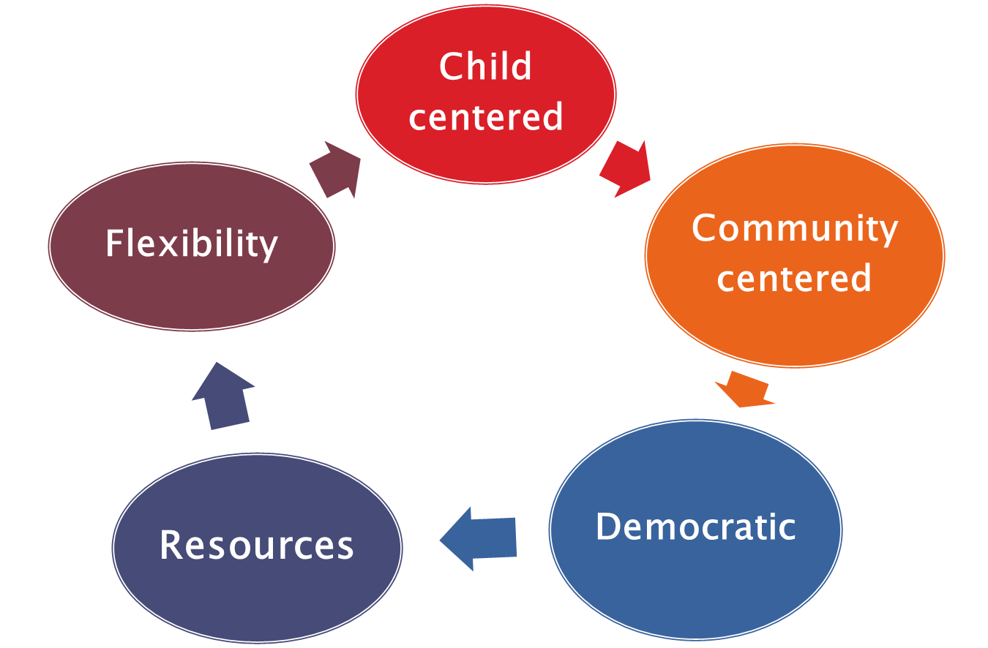
Principles of School Administration

Slide 6
Principles of School Administration
Sharing Responsibility
Equality
Freedom
Co-operation
Justice
Recognition individuals worth
Leadership
Demographic
Philosophy
Efficiency
Optimism
Professional growth
Relative value

Slide 7
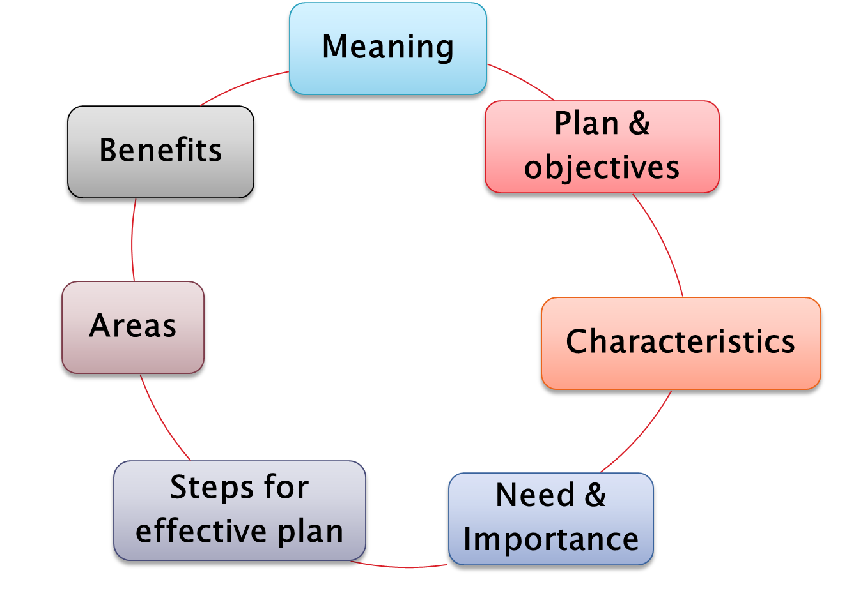
Institutional planning

Slide 8
Definition of Institutional planning
“Institutional planning is a programme of development and improvement prepared by an educational institution on the basis of its felt needs and the resources available or likely to be available, with a view to improving the school programme and school practices, constitutes a plan for an institution. It is based on the principle of optimum utilisation of the resources available in the school and the community.” – M.B Buch

Slide 9
Characteristics Or Requisites Of A Good Institutional Plan
Need based and not grant based
Optimum utilization of resources
Co-operative affair
Goal oriented
Prospective plan
Specific plan
Improvement motivation
Democratic outlook
Collaboration with the community
Basis of district plan
Eliminate wastage
Developing work culture
Inspection
Child Centered
Scientific

Slide 10
Objectives of institutional planning
Sh. J.P. Naik, Education Advisor, Government of India, has listed the following four objectives of institutional planning:
Giving freedom to the teacher.
Making the good teacher effective.
Involving every teacher in the formulation and implementation of plans.
Emphasizing what can be done here and how mobilizing our existing resources.

Slide 11
Characteristics and Components of Institutional Planning
Important characteristics include being
  Need-based,
  Goal-oriented,
  Utilizing resources optimally,
  Involving cooperative participation
  Evaluation and
  Development.
  Components:
  Objectives
  Present status
  Improvement needed
  New resources required
  Time schedule and POA

Slide 12
Steps in preparation and scope of institutional planning
Steps in preparation
Survey
Preparation
Execution
Evaluation
Scope
Curricular Activities
Co- Curricular Activities
Beautification of campus
Social Service

Slide 13
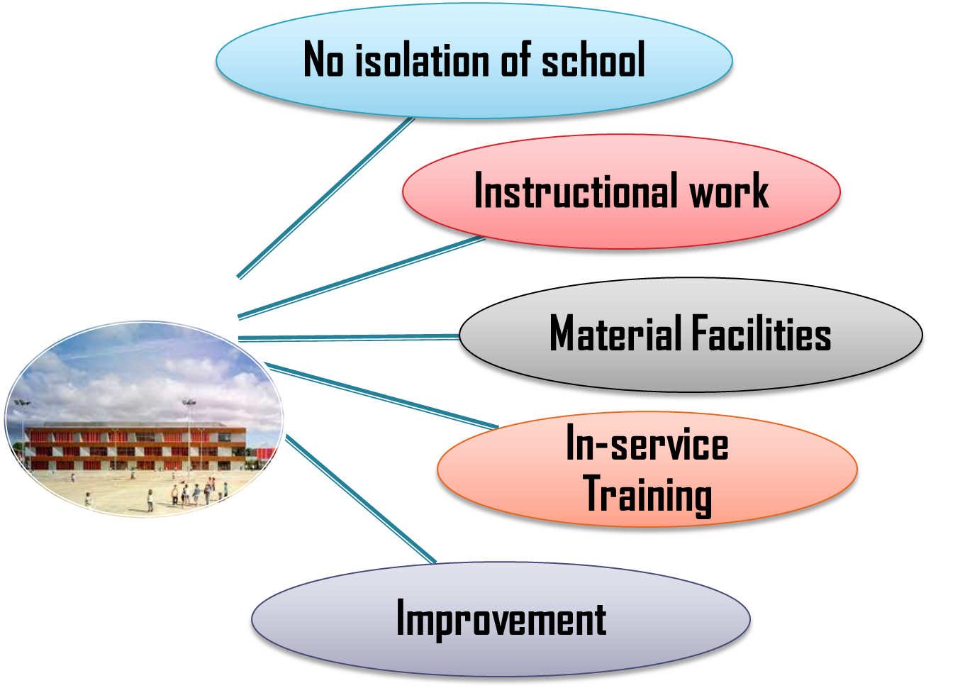
School Complex

Slide 14
School Complex
"school complex" refers to a group of public schools, typically located in a specific geographical area, that collaborate and share resources to enhance the overall educational experience for students.
School Complex is organized by taking a group of Elementary Schools, Secondary Schools and Senior Secondary Schools.

Slide 15
Objectives and Functions of School Complex
Objectives:
To break the isolation
Encourage group efforts
Utilize resources
Assist solving problems
Assist common planning
Provide Guidance
Improve educational standards
Functions:
Academic guidance
  Division of syllabus for preparing of unit plan, Discussion on new method of teaching, Team teaching, Tours and excursions, Inter-School Tournaments, Helping various projects , Preparation of good lesson plans.
Equipment assistance-
Supervision
Evaluation
In service education
Educational information
Administration

Slide 16
Democratic Administration in Education
several principles guide the decision-making process and the interactions among stakeholders. Sharing responsibility. All individuals involved in the educational management process share the responsibility of their work.

Slide 17
School plan
Recommendations of the Secondary education Commission(1952)
Buildings
Recommendation of Indian Education Commission(1964-1966)
Staffrooms
Classrooms
Library and Drawing room
Laboratories
Play ground
Washrooms
Garden
Furniture
Equipment
Canteen

Slide 18
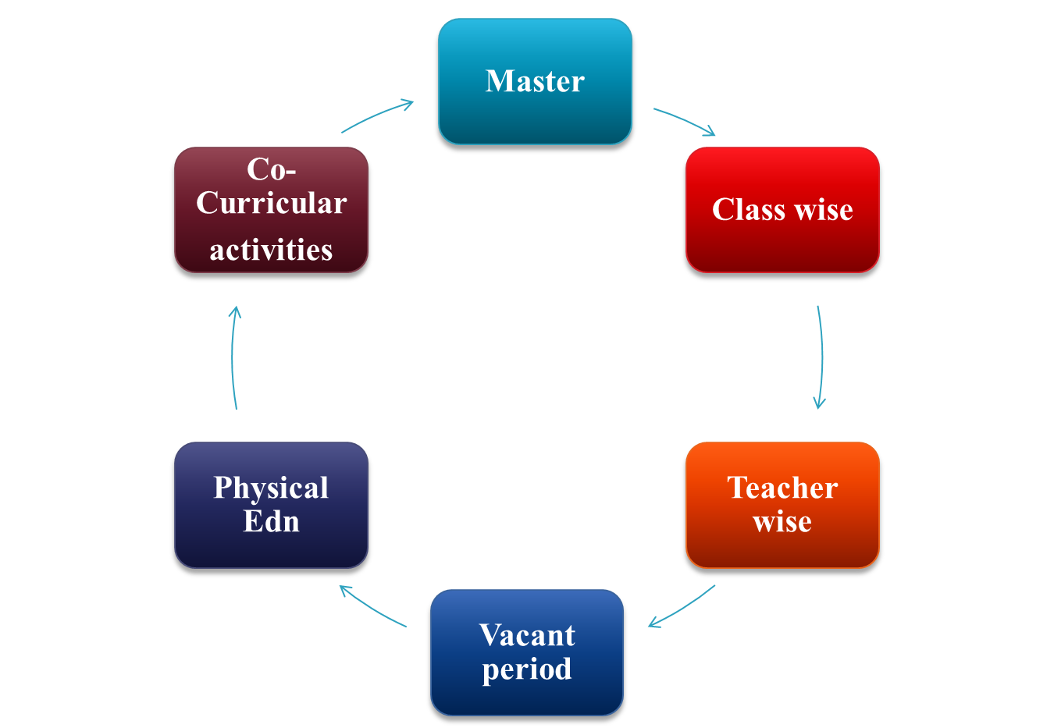
Time -Table
Time Tables

Slide 19
Time -Table
A school time table is a schedule that organizes and allocates time for different subjects, activities, and classes within a school day.
Time table is a detailed plan showing the schedule of time allotment to various subjects and activities. usually, time table is prepaid for a week, to be repeated. All the work in school is carried out systematically in tune with the time table. The successful working of a school depends on a suitable time table.

Slide 20
Role of Headmaster/Headmistress in School Administration
They are responsible for the overall leadership, management, and strategic direction of the institution, ensuring academic excellence, a positive school culture, and the well-being of students and staff.

Slide 21
Role of Head Master/Head Mistress
1.Role in Planning
    Planning before the opening of the school
    Planning during the first week
    Planning during the year
    Planning at the end of the year
    Planning of the next year
  2. Roll in school Organization
    Organizing instructional work
    organizing co- curricular activities
    organizing the school plan
    Organizing school office
  3. Teaching role
  4. Rolling supervision
  5. Role in guidance
  6. Roll in maintaining relations- Relations with staff, Relations with the pupils, Relationship parents and Relations with the community

Slide 22
Responsibilities of a Headmaster
Leadership and Vision:
  Setting the school’s strategic vision and ensuring its goals align with the educational philosophy and values.
Academic Oversight:
  Monitoring teaching standards, curriculum implementation, and student performance to maintain academic excellence.
Staff Management:
  Recruiting, mentoring, and managing staff, including teachers and administrative teams, to create a motivated workforce.
Student Development:
  Promoting student well-being, safeguarding, and opportunities for extracurricular engagement.
Operational Management:
  Overseeing budgets, school policies, and daily operations, ensuring the institution runs efficiently and complies with legal and regulatory requirements.
Community Engagement:
  Acting as the face of the school, fostering relationships with parents, alumni, local authorities, and other stakeholders.

Slide 23


