Slide 1
Pedagogy Part –II
Unit-I
UNIT-LPEDAGOGICALANALYSIS
Paradigm shift from pedagogy to Andragogy to Heutagogy Concept and stages Critical Pedagogy Meaning Foster independent thinking through critical pedagogy. Need and its implications in Teacher Education Interaction Analysis Flanders Interaction analysis, Galloway's system of interaction analysts (Recording of Classroom Events, Construction and Interpretation of Interaction Matrix)
Dr. A. Packiam,
Asst. Prof . Phy. Science Edn.

Slide 2
Meaning of Pedagogy
The word pedagogy comes from the Greek word paidagogeo. [Latin paedagogia) in which paidos means "child" and agogos mean "lead": so it means "to lead the child" or "to guide the child.
Pedagogy refers to educational schools of thought or philosophies regarding how people learn and how teachers should assist in that learning.
Pedagogy is the science and art of education. It means style and strategies of the teacher's instruction.

Slide 3
It is the study of being a teacher. The term generally refers to strategies of instruction or a style of instruction.
Webster says - pedagogy means "the art or profession of teaching".
he word pedagogue means, teacher, schoolmaster, educator, educationalist, etc.

Slide 4
Meaning of Pedagogical Analysis
Pedagogical Analysis
Pedagogical
Science & Art of Teaching
Bifurcating a topic into units
Analysis

Slide 5
Content Analysis
Formulation of instructional objectives.
Learning experience and chosen method.
Evaluation method

Slide 6
Paradigm Shift In Pedagogical Analysis
From Pedagogy → Andragogy → Heutagogy
PEDAGOGY
Modern changes in teaching–learning process
Movement from teacher control to learner independence.
ANDRAGOGY
Andragogy is the study of teaching and learning with adults.
This concept of andragogy was first defined by Alexander Kapp in 1833.

Slide 7
Developed five assumptions of andragogy- Knowles (1970)
Adults are self-directed learners.
Adults bring a great deal of experience into the classroom.
Adults who seek education are ready to learn.
Adults are internally motivated.
Adults want problem-based learning.

Slide 8
Heutagogy
Meaning – The study of self determined learning .
- Highest level of learning.
-learning should not teacher centric or content centric.
Characteristics
Heutagoical approaches an encourage the students to find their own problems and questions to answer.
Teachers help by providing context to student's learning and creating opportunities
Teacher provides the material but students decide how to negotiate the learning process.

Slide 9
Principles of Heutagogy
Knowing how to learn is a crucial skill.
Educators focus on learning process rather than content.
Learning goes beyond the specific discipline.
Learner Agency & Autonomy: The learner has total control over the learning path and direction.
Self-Determined Learning: Focuses on how to learn rather than just content acquisition.
Capability Development: Encourages transferring knowledge to new and unfamiliar situations.
Double-Loop Learning: Students reflect on their learning processes, beliefs, and actions to improve future outcomes

Slide 10
Comparison of Pedagogy Andragogy and heutagogy
Feature | Pedagogy | Andragogy | Heutagogy
Learner Status | Dependent | Independent | Independent
Focus | Subject-centered | Problem-centered | Problem-oriented / Capability
Motivation | External | Internal | Self-efficacy
Teacher's Role | Director | Collaborator | Capability-builder

Slide 11
The Pedagogy Andragogy Heutagogy Continuum PAH Continuum
Pedagogy: Start with a known subject, the delivery of which a teacher is confident with.
Andragogy: Negotiate with the learners how they might study that subject in ways that motivate them.
Heutagogy: Offer creative ways in which they might express what they have learned

Slide 12
Principles of Heutagogy
Recognize that learning is non-linear.
Individualize learning as much as possible.
Provide flexible or negotiated assessment.
Use experiential learning techniques.
Facilitate collaborative learning.
Provide lots of resources and let the learner explore.
Differentiate between knowledge and skill acquisition (competencies) and deep Learning.
Have confidence in the learner.

Slide 13
Critical pedagogy
Meaning: Critical pedagogy is a philosophy of education and social movement that developed and applied concepts from critical theory and related traditions to the field of education and the study of culture.
Implication of Critical Pedagogy:
Challenge yourself
Change the classroom dynamic
Present alternative views
Change your assessments
Encourage activism

Slide 14
Foster common Techniques through critical pedagogy
Reading
Questioning ( student )
Questioning ( Teacher)
Argumentative essays
Discussion
Debate
Modeling
New Media
Conference
Role playing
Concept maps
written feedback
Case studies
thought experiments

Slide 15
Interaction analysis
Interaction analysis is a systematic technique used to observe, record, and evaluate communication, primarily focusing on teacher-student dynamics in educational settings. Flanders Interaction Analysis Categories.
System of Interaction Analysis
  Method to study classroom interaction
  Observes teacher and student behavior
  Records classroom events
  Measures teaching effectiveness
  Improves teaching methods
  Helps classroom management

Slide 16
Interaction analysis
Assumption of interaction analysis:
Predominance of verbal communication
Higher reliability of verbal behavior
Consistency of verbal statements
Teacher's influence
Relation between student and teacher
Relation between social climate and productivity
Relation between classroom climate and learning
Use of observational technique
Role of feedback

Slide 17
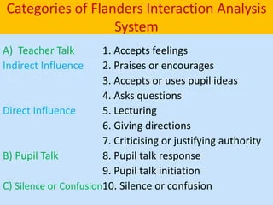

Slide 18
FIAC ( Flanders Interaction Analysis Categories
1. Accepting feeling: -This category involves the interpretation or advancement of ideas presented by the students.
2. Praises: -The instructor honours the action or behaviour of the students in this group. Smiling, jokes, nodding, 'yes,'' Nice' and 'fine‘
3. Use Student Ideas:- Clarification or the development of ideas as presented by the students is included in this group.
4. Asking Questions:- In this category an instructor asks questions about content or procedure in order for a student to respond
5. Lecturing: - In this group, an instructor discusses the facts or opinions about the material or process.

Slide 19
FIAC ( Flanders Interaction Analysis Categories
6. Giving Directions: - In this type, the teacher offers guidance, directions or directives for students to obey.
7. Criticizing: -This last category involves breaks, brief silences and intervals of uncertainty in which the listener is unable to understand contact.
8. Student Talk Response:- Talk by pupils in response to the teacher. freedom to share your ideas
9. Students Talk Initiation:- Talk by pupils, which they initiate. Expressing own ideas
10. Silence: -

Slide 20
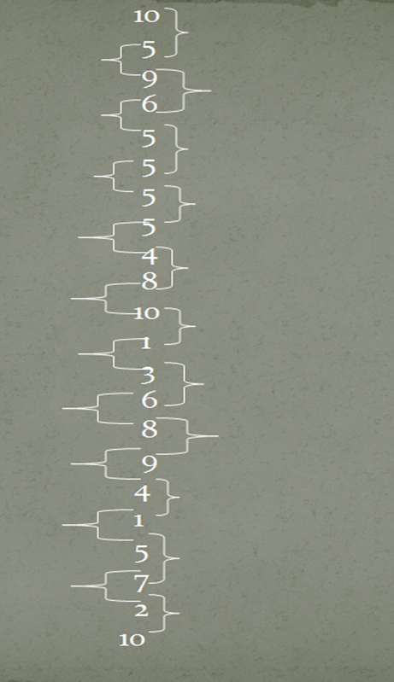
FIAC ( Flanders Interaction Analysis Categories
Procedure of FIAC
Encoding Process
  Memorize the code No.
  Place sitting
  Recording the category number
Decoding process

Slide 21
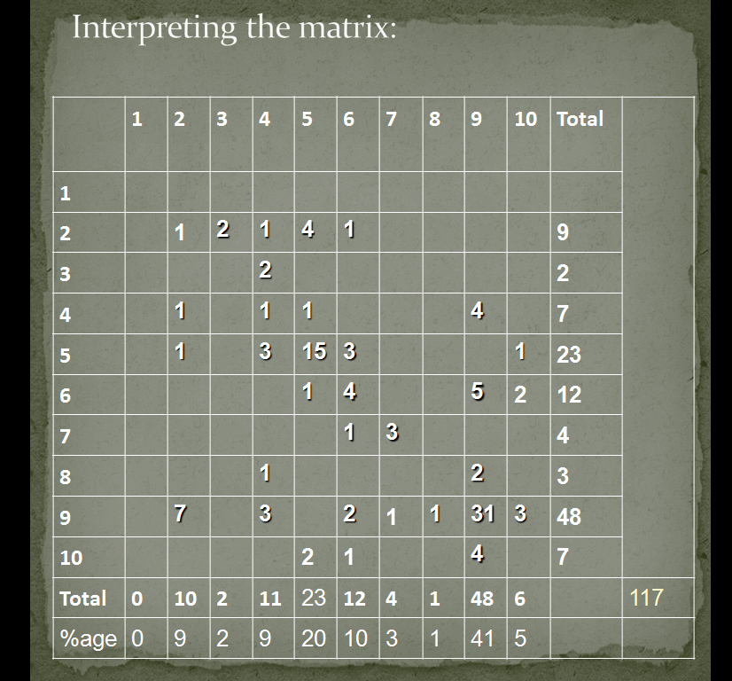

Slide 22
INTERPRETATION
Total Teacher Behaviour (TTB) Or Teacher Talk(tt):
It represent the performance of a teacher in terms of action reflecting the tendency of teacher talk. It can be concluded as below:
Total of categories 1 to 7
TT= x100
N
Indirect Teacher Influence /Talk (ITT)
It represents the performance of the teacher in terms of his action encouraging and supporting student’s participation:
Total of categories 1 to 4
ITT= x100
N

Slide 23
Interpretation of Interaction Matrix
Shows teacher talk percentage
Shows student participation
Shows classroom interaction
High teacher talk = Teacher-centered
High student talk = Active learning
Balanced interaction = Effective teaching

Slide 24
Galloway’s system of interaction Analysis
Galloway's Interaction Analysis is a systematic, teacher-training observational technique designed to analyze both verbal and non-verbal teacher behavior in the classroom.
Three Major Sections: The system divides interaction into
  Teacher Talk,
  Student Talk, and
  Silence/Confusion.

Slide 25
Galloway’s system of interaction Analysis
Assumptions
1. Non-verbal communication of a teacher do, bas a significant role in classroom interaction
2. As one cannot see when he/she behaves, so, feedback is necessary for the behaviour
3. The non-verbal cues are important, as they can reinforce and can motivate a student
4. Non-verbal communication can be more effective during interaction in the classroom
5. Becoming aware of his non-verbal events occurring around us, one can achieve a better understanding of himself
6. Training of teachers enhances the aspect of non-verbal communication in teachers
7. The system is based upon the theory of modification of the teacher's behaviour

Slide 26
Galloway’s system of interaction Analysis
Steps
Recording of classroom events
Construction of interaction matrix
Interpretation on interaction matrix
Recording Classroom Events
Appropriate position
No interference of disturbance
Proper coding (Memorization of codes)
Noting at every 3 seconds
Column or row

Slide 27
Communication is a process of sharing or exchanging, experiences, information, ideas, opinions, thoughts and so on.
Classification
  Verbal communication strategy : Language is the key and base of any verbal communication. Ex: Oral, witten, oral plus written
  Non-verbal Strategy: It refers to all external stimuli other than spoken or written words. Ex:Facial ExpressionLanguage of EyeBody languageSound symbols

Slide 28

Conclusion
Critical pedagogy improves thinking.
Encourages independent learning.
Interactions analysis improves teaching.
Helps effective classroom learning.

